Slide 1

Price Predictor
Project 4
Rodrigo Figueroa
Daniel Bardan
Pablo
Carlos Valencia
José franco

Slide 2

Index
Model Building
Difficulties
Model
Sources

Slide 3

Libraries
Pandas
Numpy
Joblib
Sklearn
Model Selection
Preprocessing
Ensemble
metrics
Xgboost

Slide 4

Data Splitting & Scailing
X= 'Unnamed: 0', 'Photo', 'Price', 'Model.Number', 'Year’
Y = 'Price’
scaler = StandardScaler()
X_train_scaled = scaler.fit_transform(X_train)
X_test_scaled = scaler.transform(X_test)

Slide 5
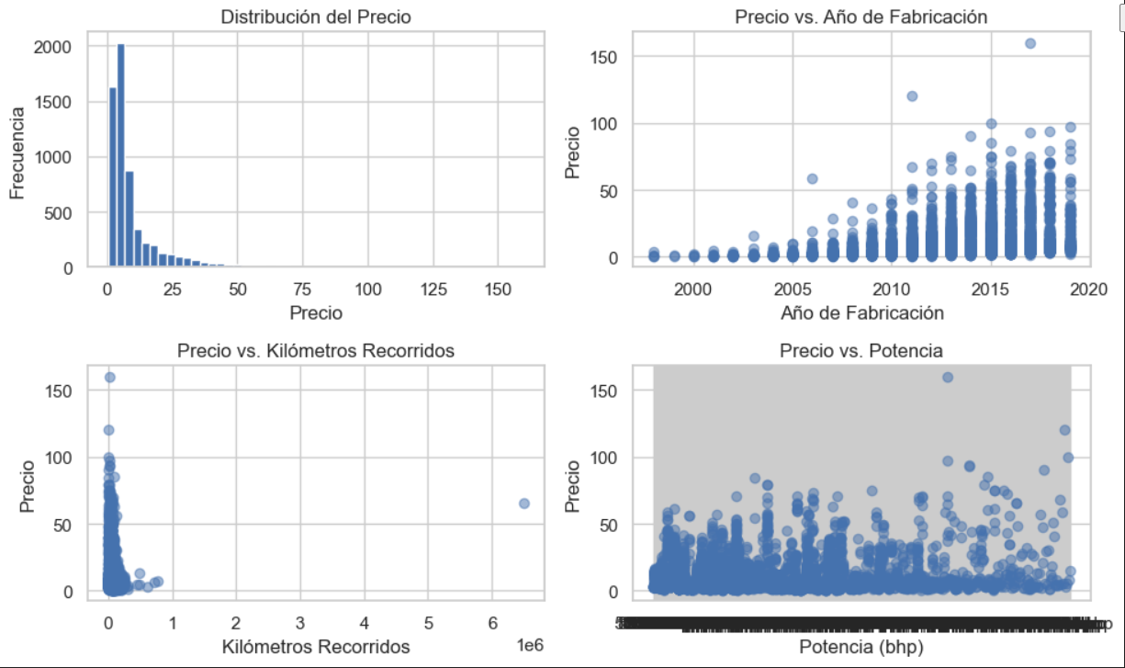
Distribución

Slide 6
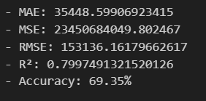
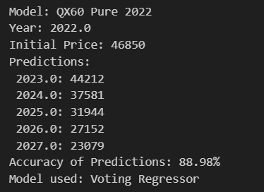
Define and Train the Voting Regressor with Weighted Models

Slide 7
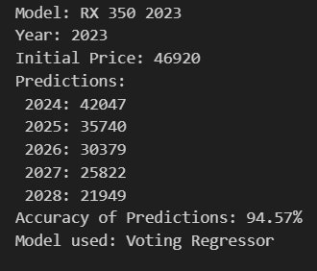
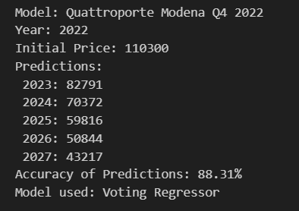
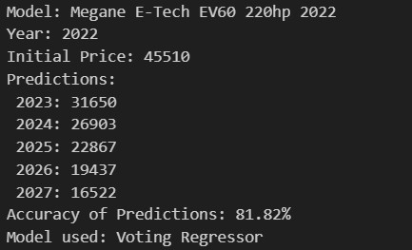
Predictions examples

